Slide 1
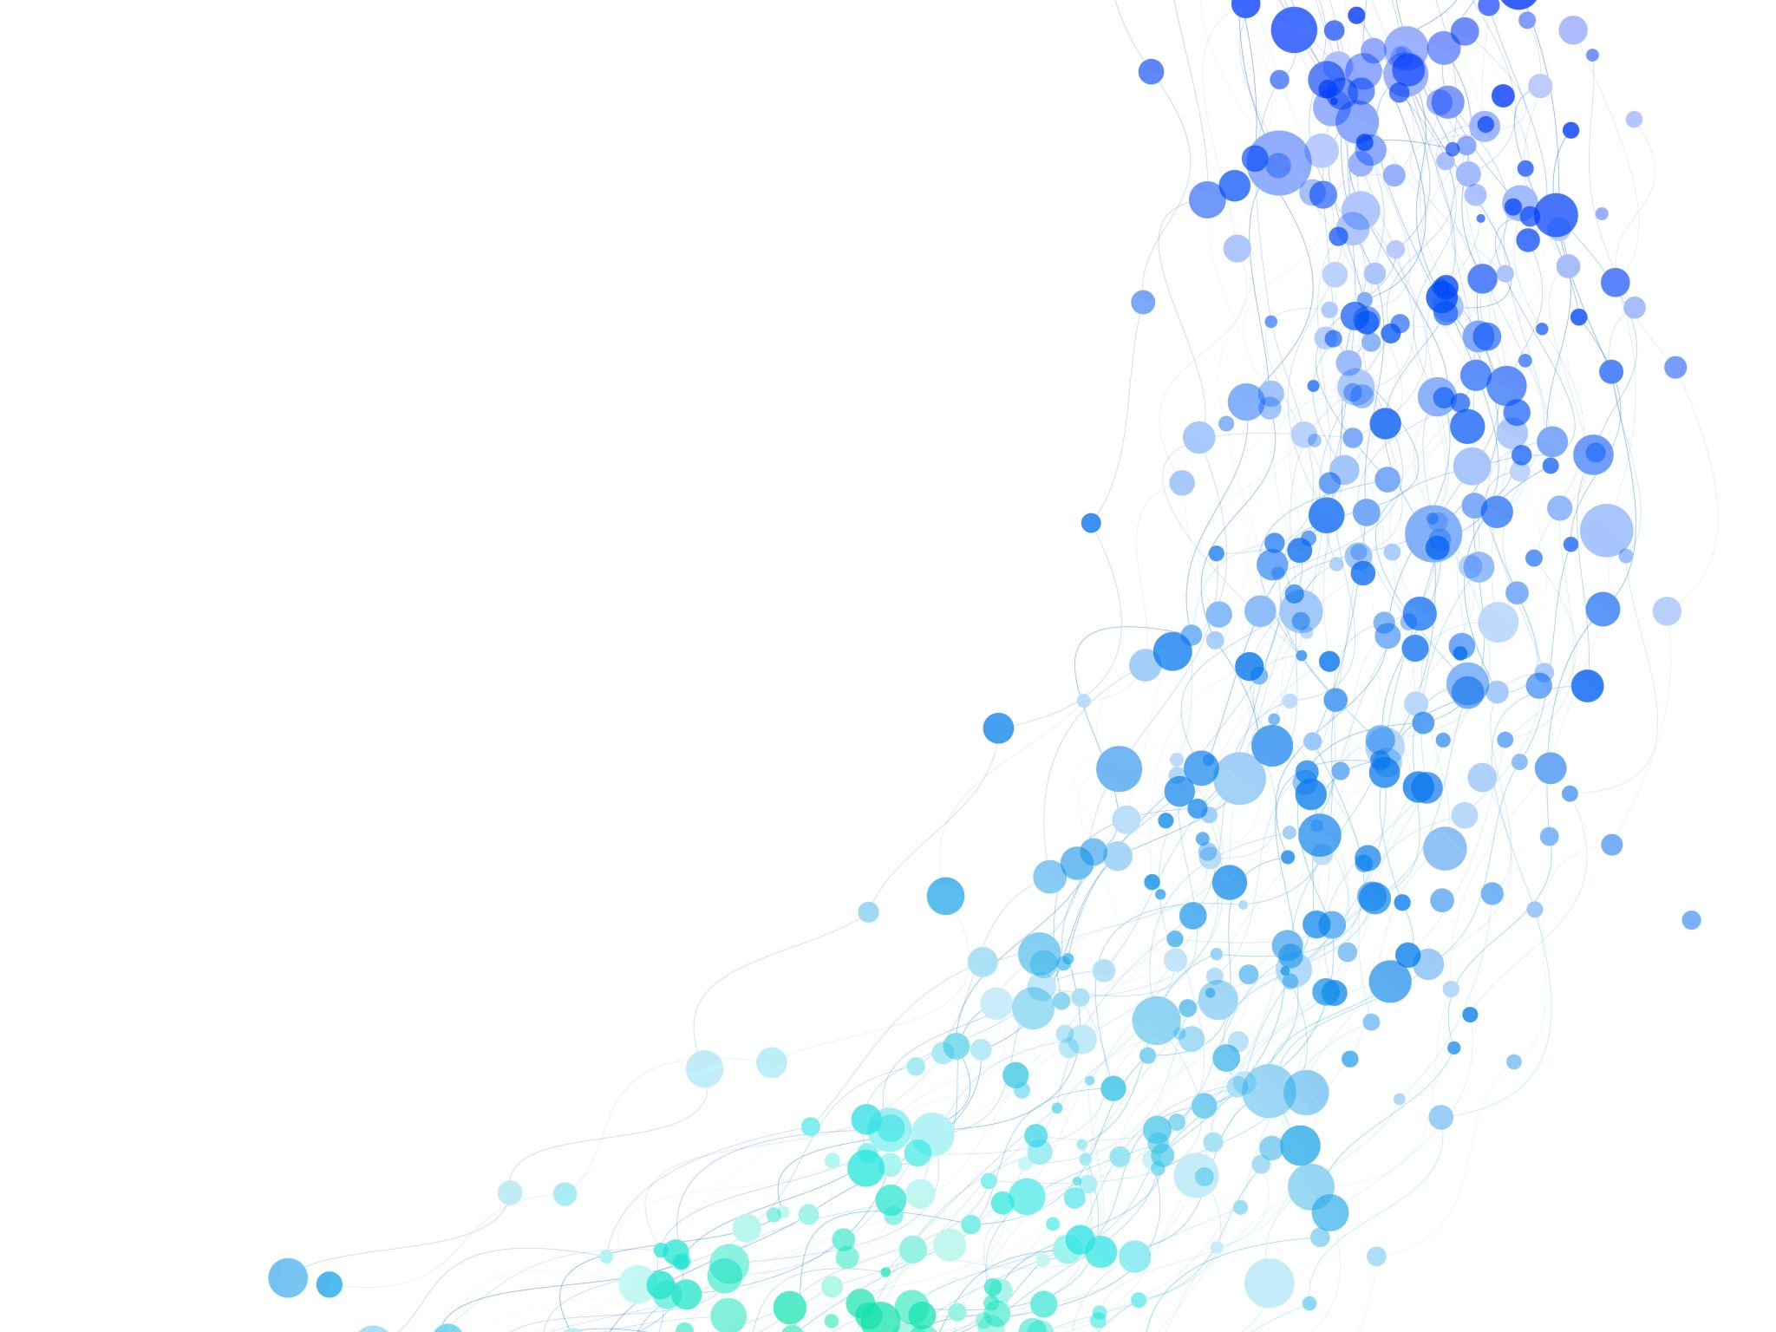
Fair Weather Play
A Look At Weather and Its Impact on Player Performance in the NFL
Arnaz Alavi
Nick Blaul
Joanne Isaac
Dan Pranjic
Jennifer Puszczewicz

Slide 2
Purpose:
We are interested in the possible relationships between certain weather conditions and its effect on quarterback performance.
Alternative Hypothesis: If adverse weather conditions are related to quarterback-performance then extremes in temperature, precipitation or high winds will result in poorer performances in comparison to neutral weather conditions
Null Hypothesis: If weather is not related to the performance of quarterbacks, game statistics will not be significantly different when playing in adverse weather conditions vs neutral

Slide 3

3 questions
Does high wind speed affect quarterback performance?
Does high or low temperature affect quarterback performance?
Does precipitation affect quarterback performance?

Slide 4

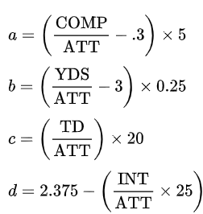
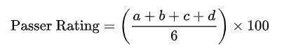
Give me the data
Source of API:
https://www.spreadtrends.com/api/metadata
Formula used to calculate QB rating:
Wikipedia:
Notes:
a = comp% = # of completed passes/attempts discuss conditionals in values a, b, c, d
b = total yds / passing attempts
c = touchdowns thrown per attempt
d = interception per attempt

Slide 5

Sample Size
5 seasons (2015-2020)
(Excluding pre-season and playoff games)
Exclusively open-air stadiums
Gametime weather conditions including wind speed, temperature, and precipitation
Position: Quarterback

Slide 6
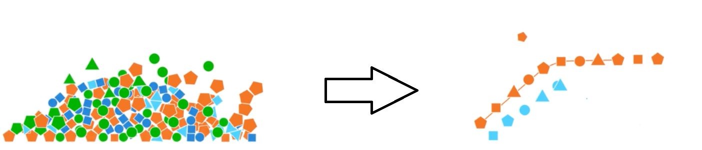
When data gets messy, clean it up!
What we did:
-Removed the following:
All positions except the quarterback
Pre-season and playoff games
Null values in QB rating
Players with less than 10 attempts per game
-Merge data frames: Weather and Player ratings
-merged on game ID
Notes:
DAN

Slide 7
NEW METHODS WE
TRIED
JSON NORMALIZE
The function:
df = pd.json_normalize(game_data, record_path = ['results'])
What it does:
Turns json format into a data frame
QUERY FUNCTION
The function:
DataFrame.query(self, expr, inplace=False)
What it does:
The query() function is used to query the columns of a DataFrame with a Boolean expression

Slide 8
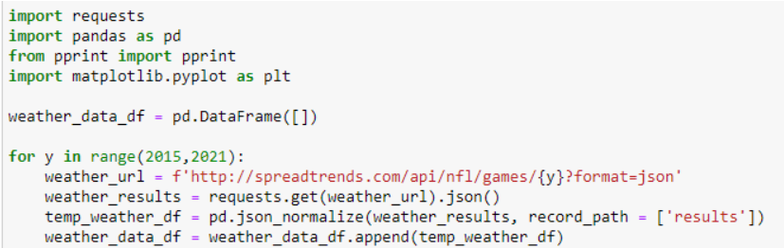
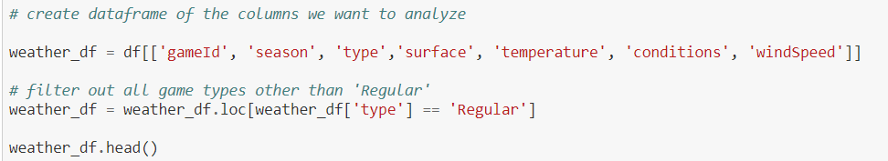
JSON NORMALIZE

Slide 9

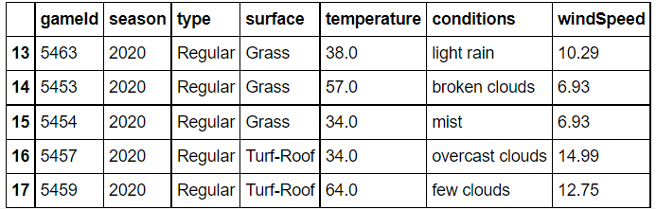
OUR DATAFRAME...

Slide 10
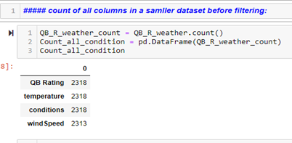
QUERY
FUNCTION:
Why we used it
Data Analysis and a Pandas DataFrame Query:
Four different datasets were created (csv files) from a URL.
We examined four datasets and identified the most relevant to our project
During the analysis phase, data was filtered using pandas.query() method.

Slide 11
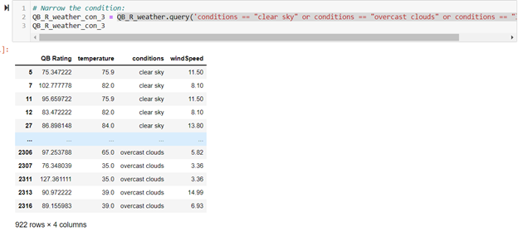
QUERY
Example:
The conditions column consisted of weather conditions such as light snow, cold, fog, shower rain, overcast cloud and clear sky. We wanted to focus our analysis on three conditions: clear sky, overcast clouds, and light snow
Example1 =QB_R_weather.query('conditions == "clear sky" or conditions == "overcast clouds" or conditions == "light snow" ')

Slide 12
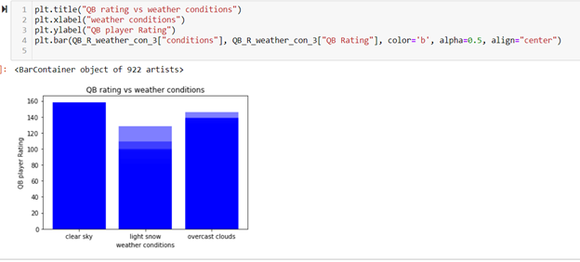
BAR
GRAPH
USING
QUERY
FUNCTION
The Function:
QB_R_weather.query('conditions == "clear sky" or conditions == "overcast clouds" or conditions == "light snow" ')

Slide 13

Picture it:
Taking the data, we created a few charts to visualize our results
We did this by….

Slide 14
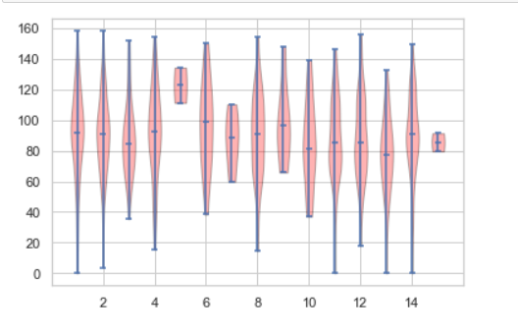
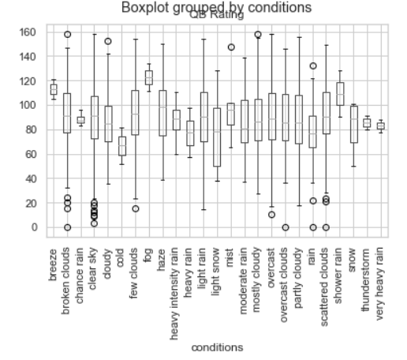
VIOLIN PLOT VS BOX PLOT
Violin Plot
Box plot
Notes:
box plots = good representation of a summary of statistics as we’ve calculated in class, such as the mean/median and interquartiles.
violin plots = the distribution of data, good choice to

Slide 15
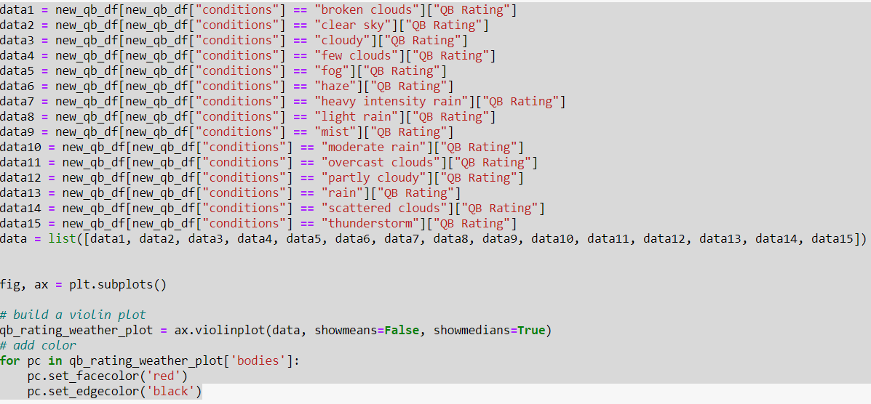
VIOLIN PLOT
THE CODE

Slide 16
VIOLIN PLOT VS BOX PLOT
ANOVA TEST & GENERAL ANALYSIS
Violin Plot
Box plot
p value = 0.35
Notes:
p value .35 failure to reject the null hypothesis. not statistically sig (might be due to sample size) 35% chance of data results being due to random chance
violin - talk about density of data
fog and breeze had the most impact - something I would like to look into

Slide 17
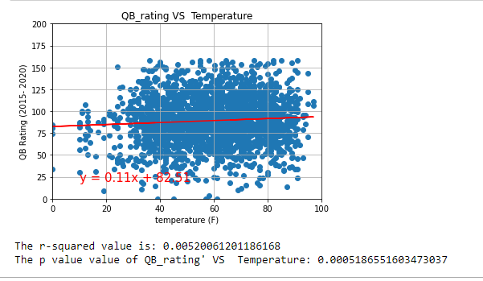
LINEAR REGRESSION
QB Rating vs Temperature
Results:
r squared value = 0.0005
p value 0.0005
What this means:
There is little correlation between QB Rating vs Temperature
Any estimate of a player’s QB rating based on temperature would only be 0.005 correct
Notes:
Graph -1 --- Scatter plot between QB rating and Temperture to identify the Linear Regression and find the relationship between QB Rating ## and Temperature. Result : r square value = 0.005
There is a very little correlation between QB rating and Temperature
Any estimate of a player's QB rating based on temperature would be only 0.005 correct based on R value.¶

Slide 18
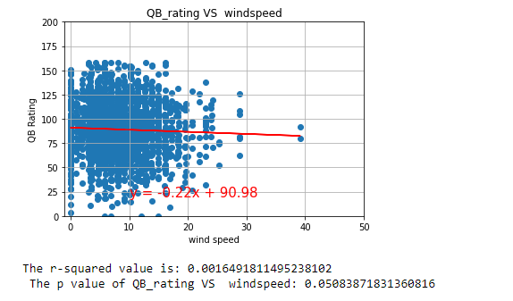
Results: r squared value = 0.0016
What this means:
There is little correlation between wind speed and QB rating
Any estimate of a player’s QB Rating based on wind speed would only be 0.0016 correct
LINEAR REGRESSION
Scatter Plot QB Rating VS Windspeed
Notes:
##### Graph -2 --- Scatter plot between QB rating and wind speed to identify the Linear Regression and to find the relationship between QB Rating ## and Wind speed
###### Result : r squre value = 0.0016
##### There is a very little correlation between QB rating and Wind Speed
###### Any estimate of a player's QB rating based on Wind Speed would be only 0.0016 correct.

Slide 19
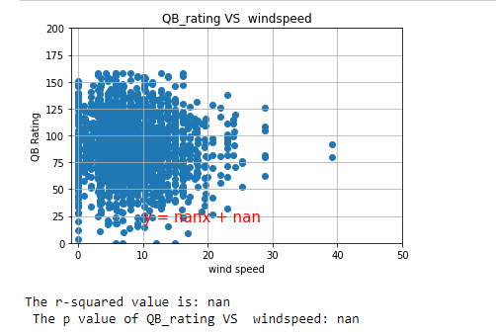
P values cannot be used to reject/accept our hypotheses
LINEAR REGRESSION
Takeaways
Notes:
Lesson Learned from Linear regression
1) Clean up data first -- weather_QB_pd.dropna(inplace=True)
2) P-Value calculated by linear regression can not be used to rejected or accepting the hypothesis.

Slide 20
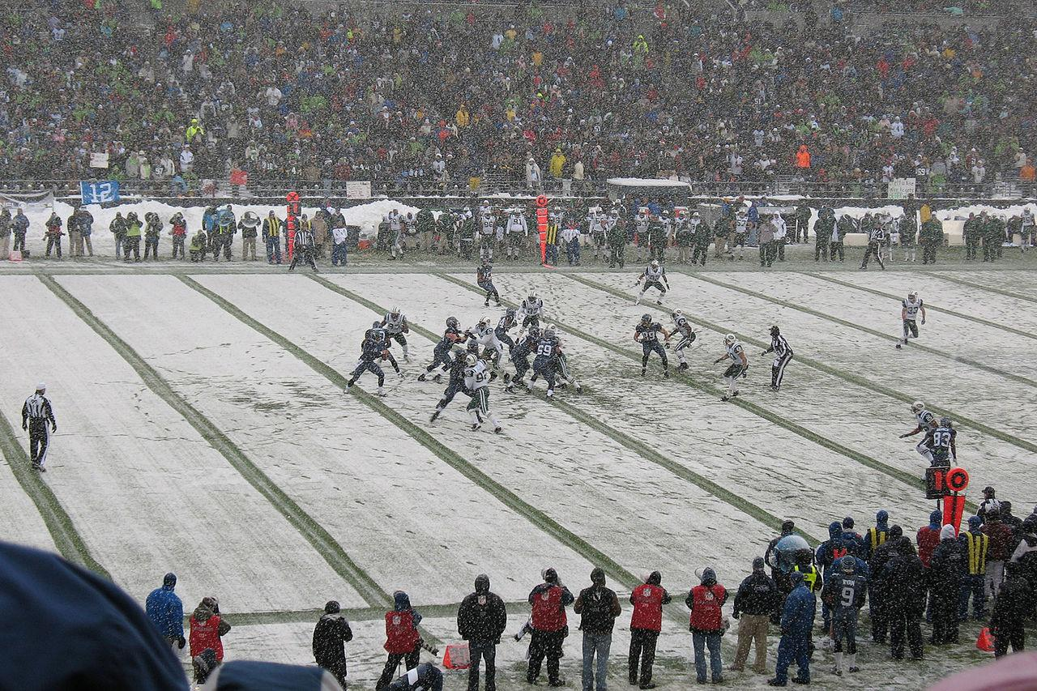
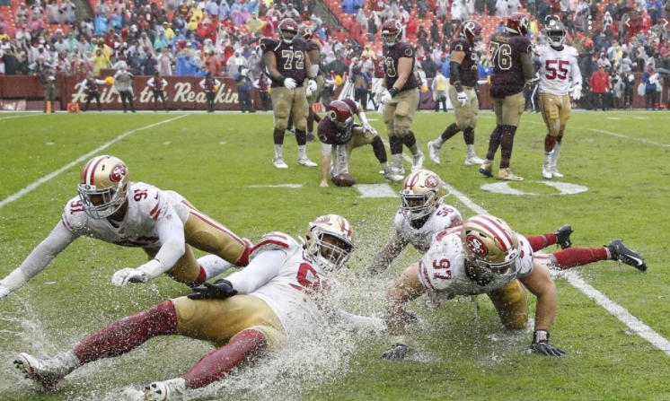
A CLOSER LOOK AT WEATHER EXTREMES...

Slide 21
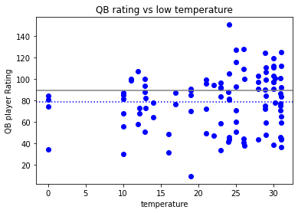
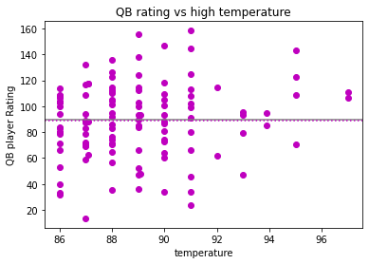
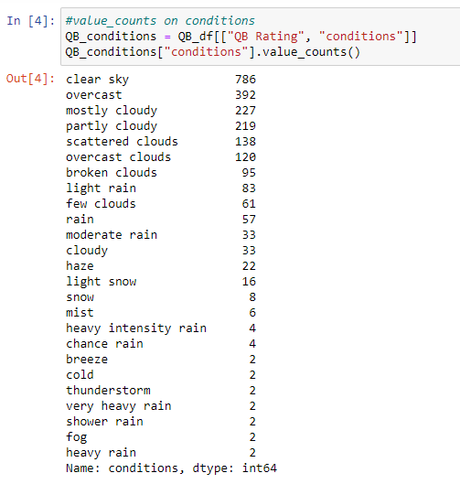
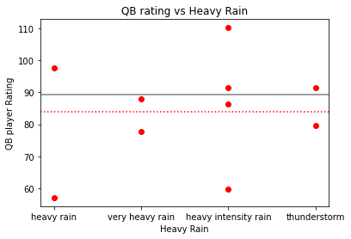
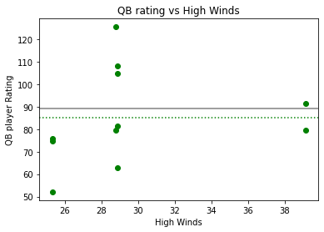
QB Rating vs Temp, Wind speed, and Rain
pvalue=0.6947630076094631
Variance = 700.6024744365968
Standard Deviation = 26.46889635849211
pvalue=0.6925400654953082
Variance = 838.7517048753682
Standard Deviation = 28.961210348936874
pvalue=0.8246792142992982
Variance = 263.239413687631
Standard Deviation = 16.22465450133318
pvalue=0.6925400654953082
Variance = 445.8688657552428
Standard Deviation = 21.115607160468837

Slide 22
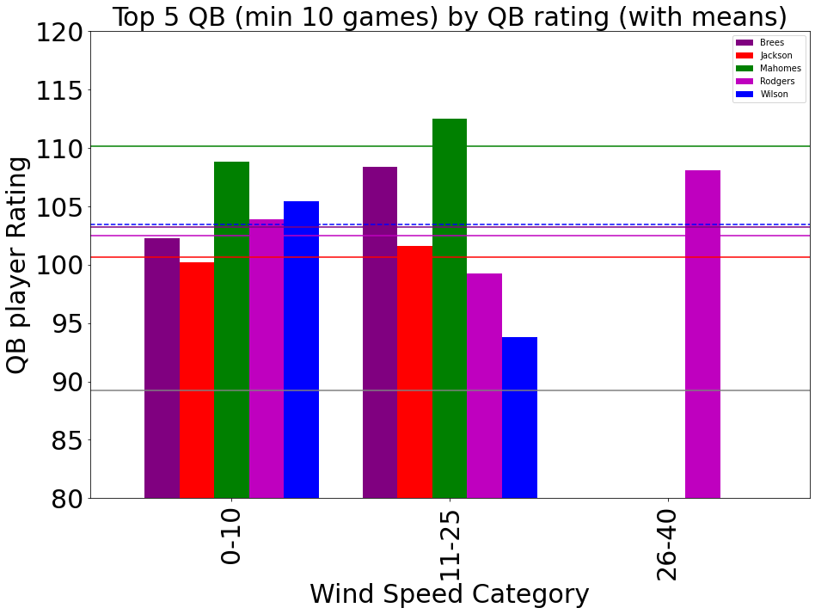
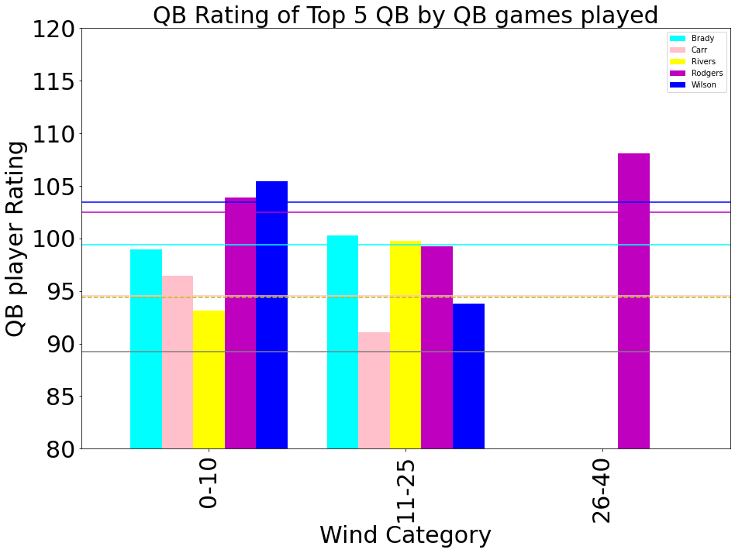
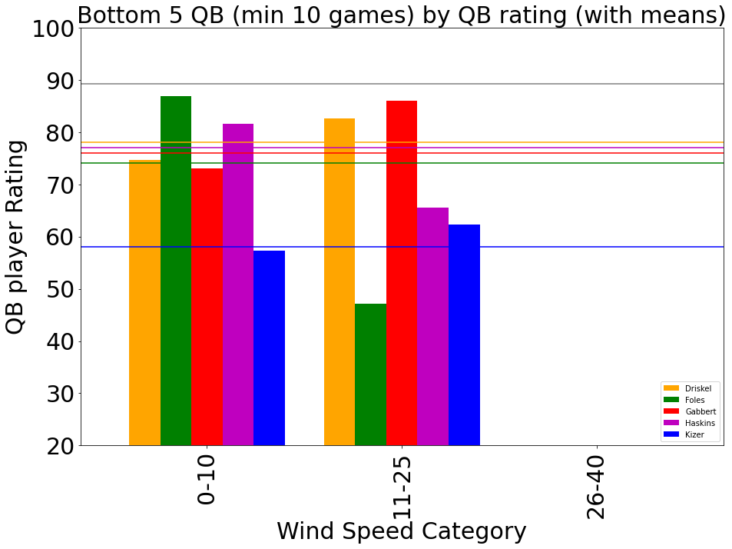
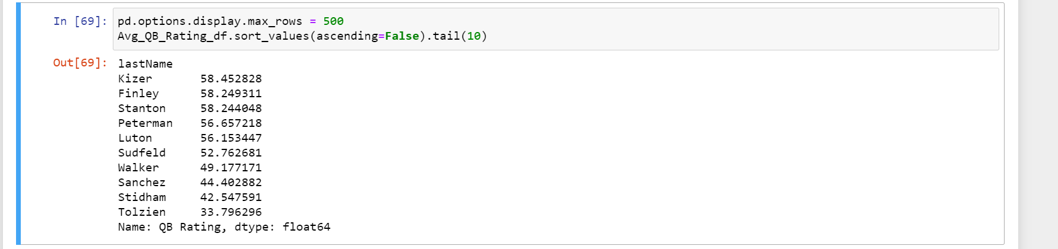
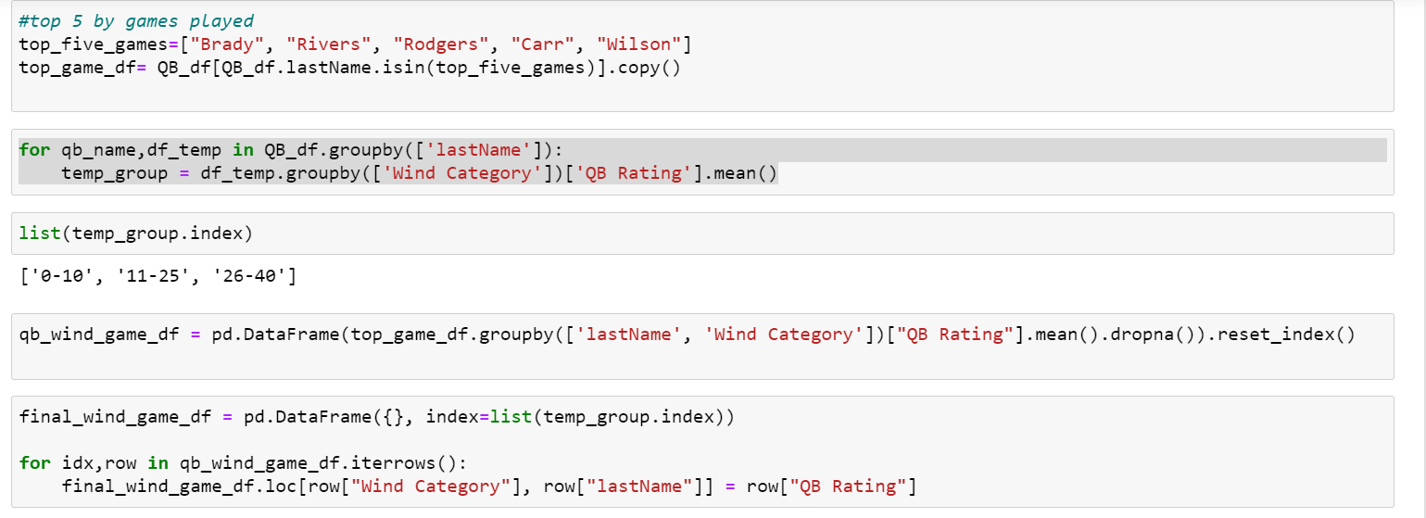
Individual Player Analysis Wind Speed

Slide 23
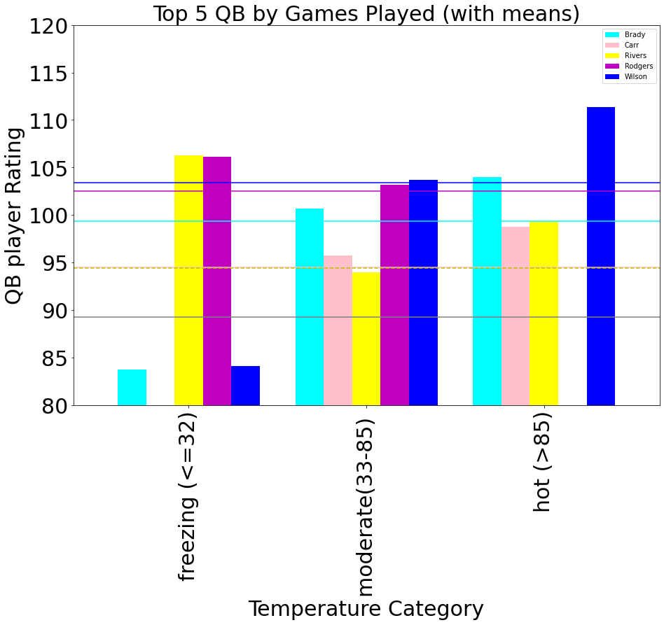
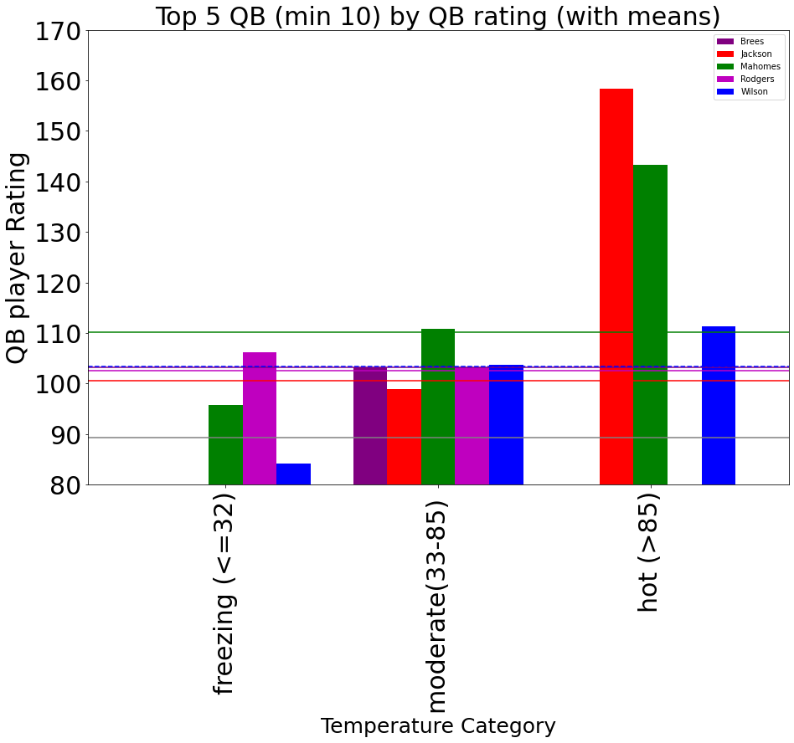
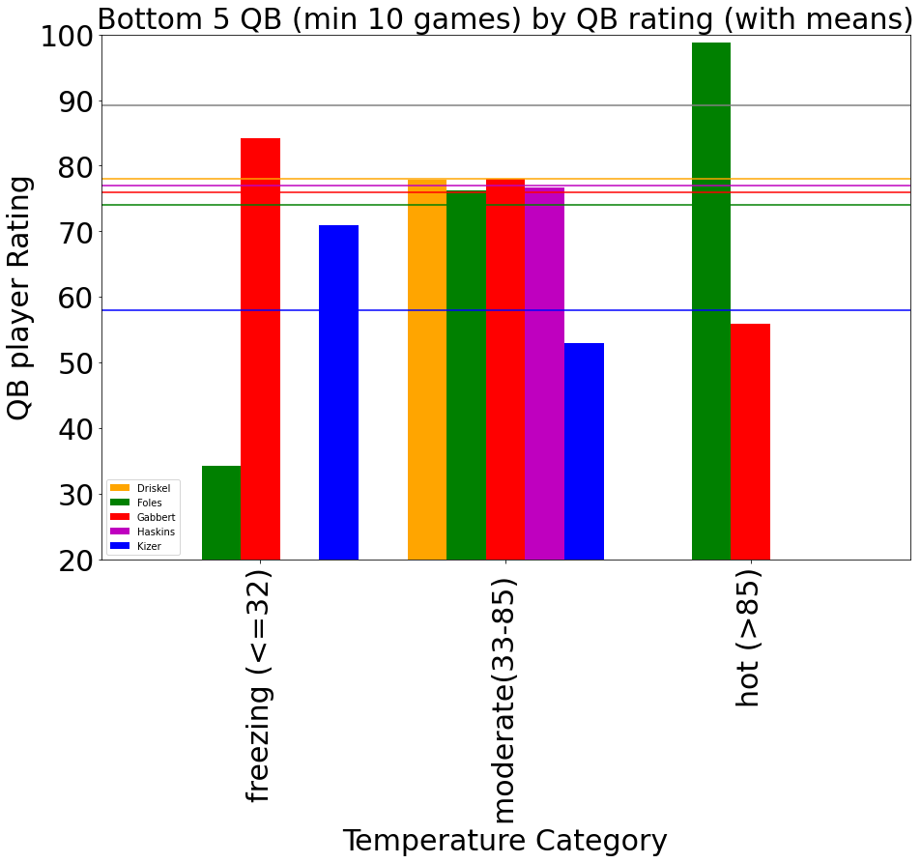
Individual Player Analysis
Temperature

Slide 24
A CLOSER LOOK AT
Whether the Weather
IMPACTS GAME STATS

Slide 25
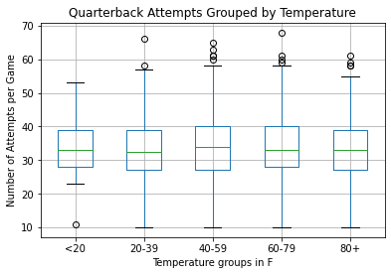
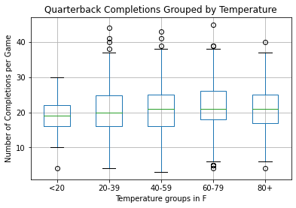
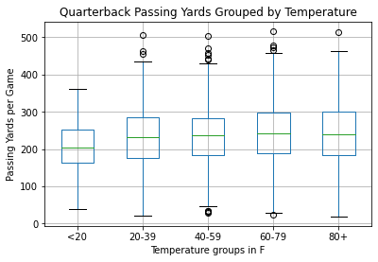
Comparing individual stats
ANOVA TEST Attempts vs Temperature: Completions vs Temperature: Passing Yards vs Temperature: | pvalues 0.569 0.010 0.007

Slide 26
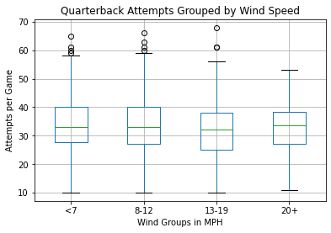
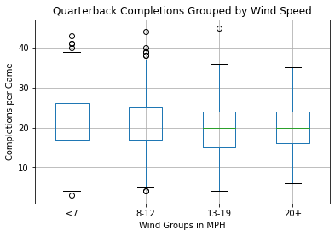
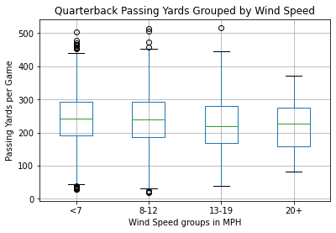
Comparing individual stats
ANOVA TEST Attempts vs Wind Speed: Completions vs Wind Speed: Passing Yards vs Wind Speed: | pvalues 0.080 0.001 0.002

Slide 27


Slide 28
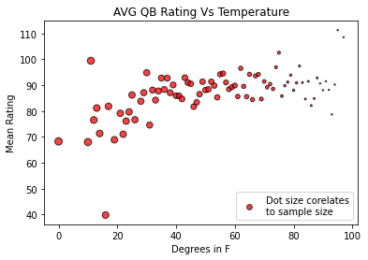
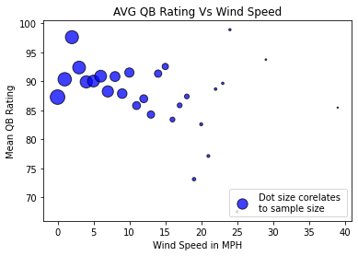
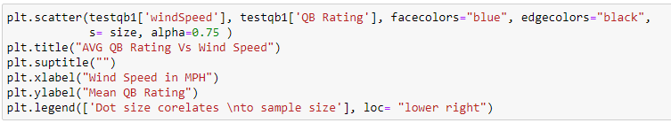

Slide 29
What we expected:
Alternative Hypothesis
If adverse weather conditions are related to quarterback-performance then extremes in temperature, precipitation or high winds will result in poorer performances in comparison to neutral weather conditions
Let’s revisit our hypotheses…
Null Hypothesis:
If weather is not related to the performance of quarterbacks, game statistics will not be significantly different when playing in adverse weather conditions vs neutral weather conditions.

Slide 30
What we found:
Based on our data...
The effect of WEATHER cannot be shown to significantly affect Quarterback ratings overall. Although the mean QB ratings were affected in games with freezing temperatures, precipitation, and high winds, there was not enough of an impact based on sample size to draw a conclusion.
WEATHER CONDITIONS alone when analyzing the top 5 and bottom 5 QB ratings are inconclusive.
Data indicates that weather may affect performance in the way Quarterbacks and their coaches approach games, resulting in differences in completions and passing yards.
Overall, Quarterback ratings varied too much in the sample of weather conditions in our data to support our alternative hypothesis.

